Slide 1
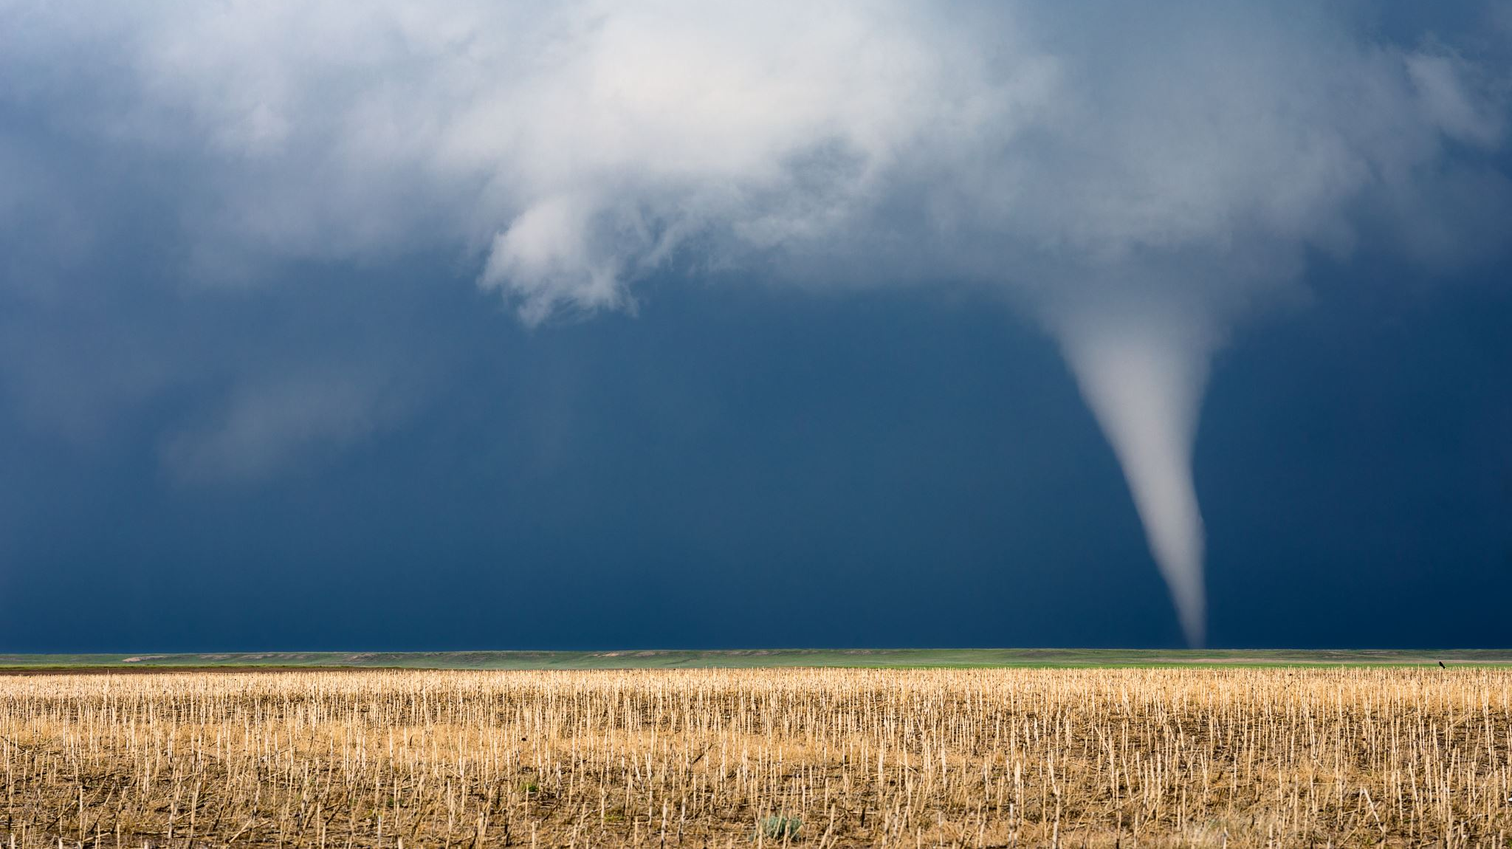
Rise in Global Temperatures and Storms From 1949 Onward

Slide 2
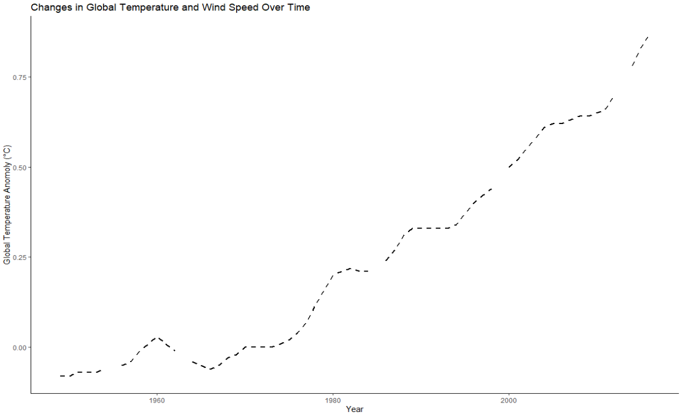
Rise in Global Temperatures Over Time
It is a fact that global temperatures have been rising throughout the years due to a combination of factors
As we can see, global temperature has risen sharply since the 1950s
Believed that these changes in temperature can have adverse impacts on our ecology
Including an increase in storm frequency and intensity
Notes:
Source: https://data.giss.nasa.gov/gistemp/graphs/graph_data/Global_Mean_Estimates_based_on_Land_and_Ocean_Data/graph.txt

Slide 3

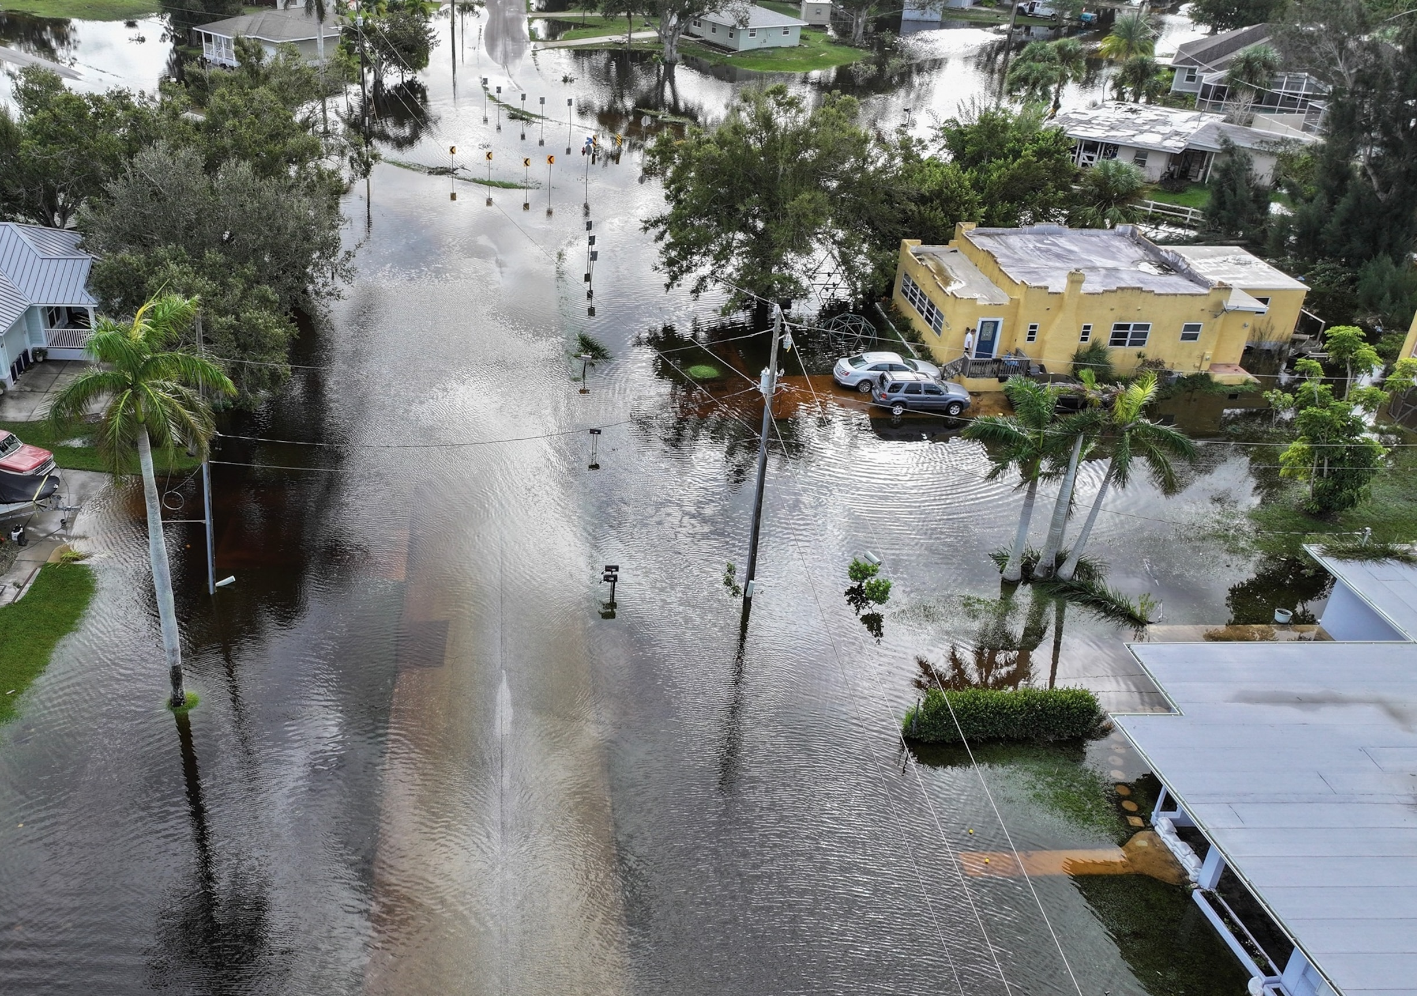

Storm Intensity Over the Years
Research suggests that hurricane frequency and intensity has been worsening over the past 100 years (edf.org)
Climate change is thought to play a large role in this situation
This is important, as worsening intensity and frequency of hurricanes can lead to increased devastation, loss of life, and costs of recovery for affected regions
Notes:
https://www.edf.org/climate/how-climate-change-makes-hurricanes-more-destructive#:~:text=Hurricanes%20are%20stronger%2C%20intensify%20faster&text=Researchers%20suggest%20that%20the%20most,Ocean%20has%20doubled%20since%201980.

Slide 4
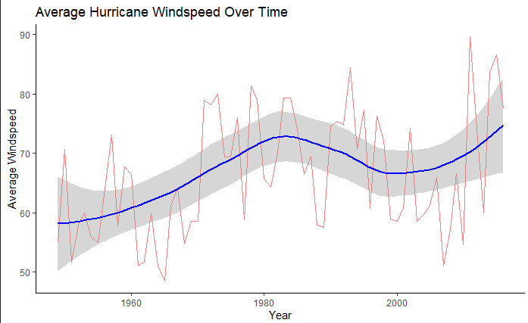
Storm Intensity Over the Years
Based on this visual, we can see that
Over time, Average windspeeds during storms have been increasing throughout the years
This increase may not be as pronounced as the increase in global temperatures
but this establishes a trend
Notes:
Source: https://www.nhc.noaa.gov/data/hurdat/hurdat2-1851-2023-051124.txt

Slide 5
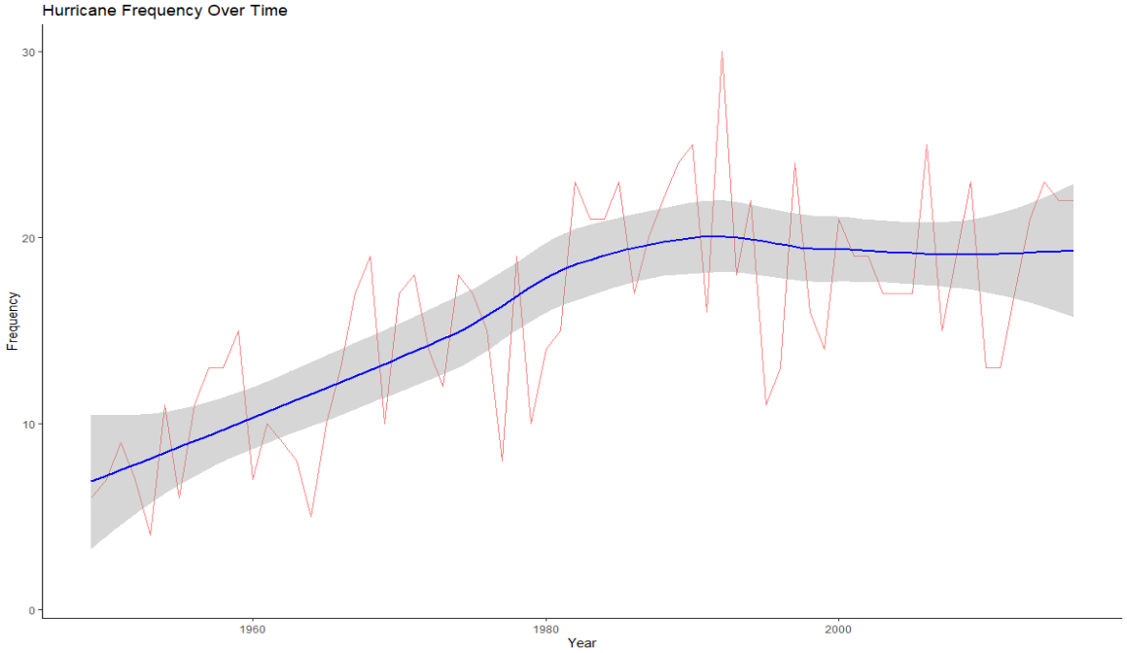
Storm Frequency Throughout the Years
Similarly, we can see that the overall frequency of storms has increased throughout the years, as well
Again, not as steeply as global temperature, but still shows a trend

Slide 6
Relationship between Stroms and Global Temperatures
Now that we have established a trend, let’s see if any relationships exists

Slide 7
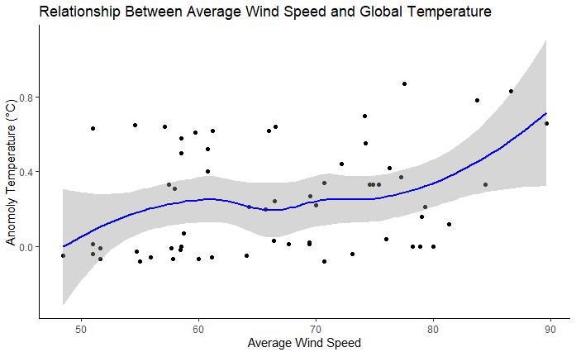
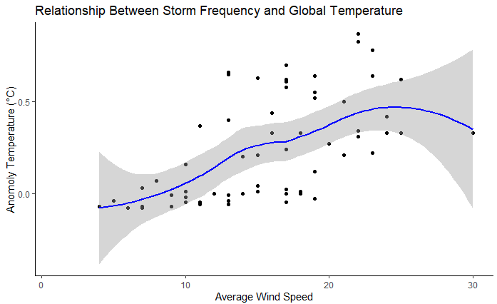
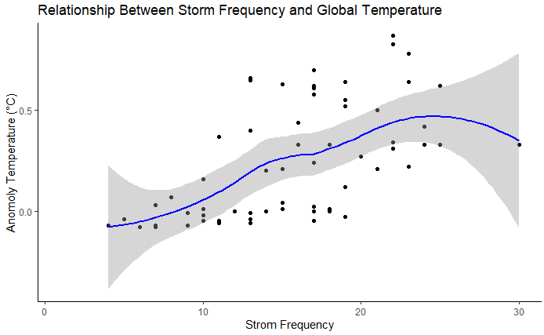
Significant relationship between average wind speed and global temperature
However, this relationship is rather weak
Still shows us that higher windspeeds are associated with higher global temperature deviations
Significant relationship between storm frequency and global temperature
A stronger relationship
Shows us that as the number of storms increases, temperatures seem to increase as well

Slide 8
But What About the Type of Storm?
Now that we have established that relationships among strom intensity, frequency, and global temperatures
We can ask the question: Which types of storms are related to changes in global temperatures
Tropical Storms?
Category 1-5 hurricanes?

Slide 9
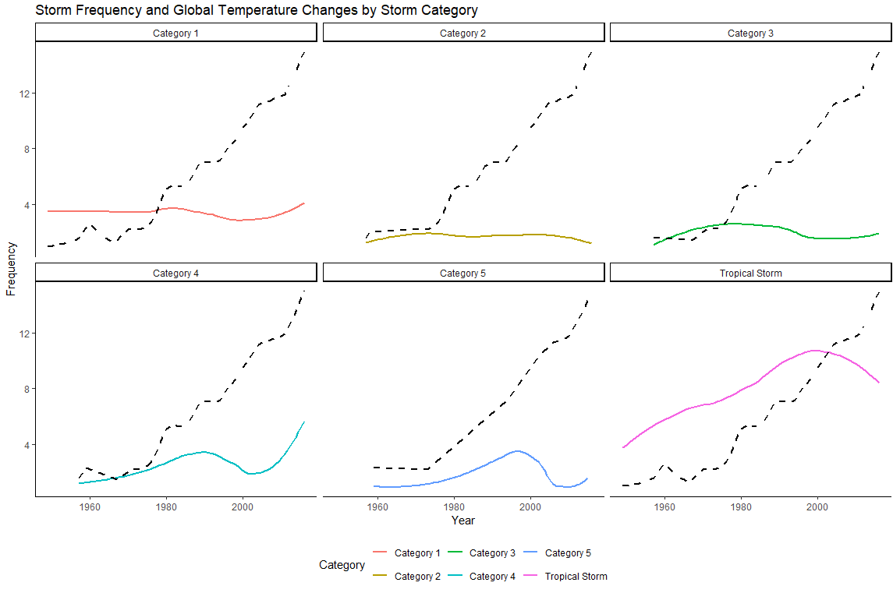
It appears that Category 1-3 hurricanes do not have as strong of a relationship with global temperatures
Category 4-5 hurricanes seem to increase as global temperatures increase over time
Importantly, topical storms appear to increase in frequency the most along side temperature changes.

Slide 10
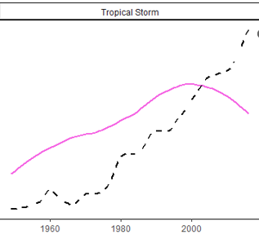
Conclusions
There are relationships between storms and global temperature changes
Weak relationships for intensity
Stronger relationships for frequency
Overall, there are more storms compared to previous points in time
Tropical storms appear to be the most prevalent
These findings suggest that the rises in global temperature from global warming are significantly related with increases in storm frequency and storm intensity

